Slide 1
Block Diagram
LTM4634EV
Triple
3.3VP@5A
MAX1847
Inverting
2VP@5A
6VP@4A
6VN@4A
3.5VP@4A
5VP
LTM4619
Dual
5VP@4A
PSOC
Power Control/ I2C/ Voltage Monitoring
LTM4622A
Single
12VP@4A
HV9110
HVP1
HV9110
HVN1
HV9110
HVP2
HV9110
HVN2

Slide 2
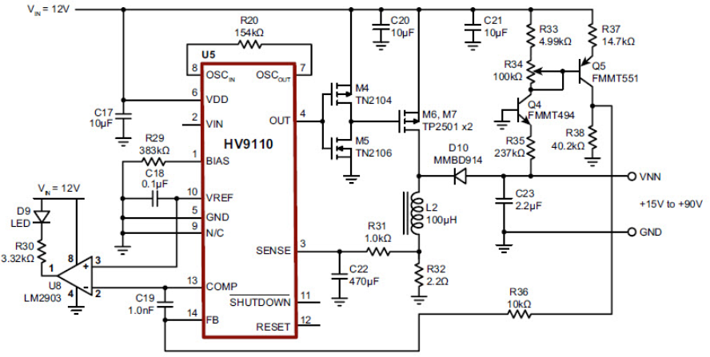
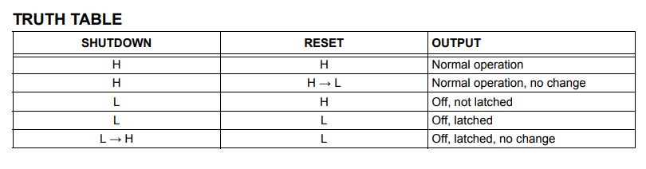
High Voltage Negative

Slide 3
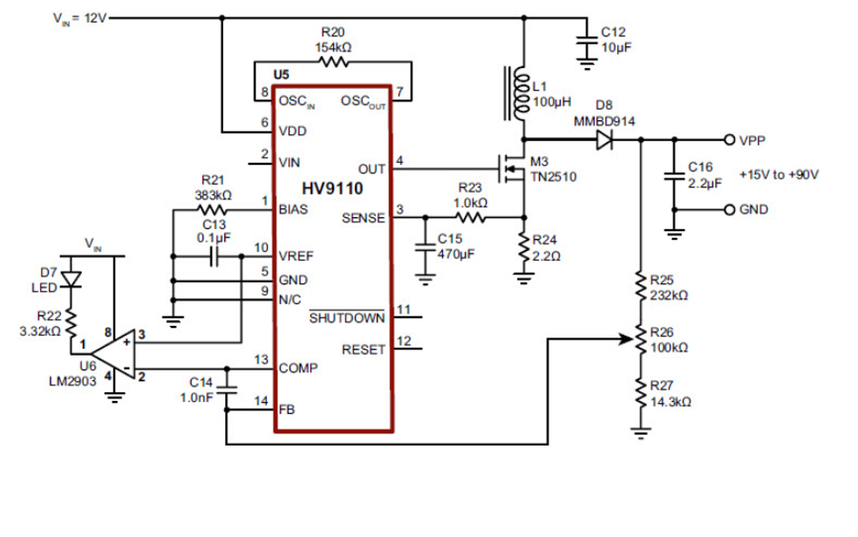
High Voltage Positive

Slide 4
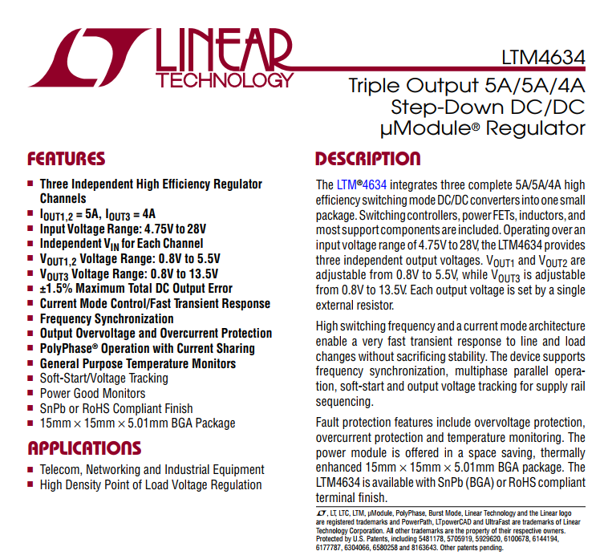
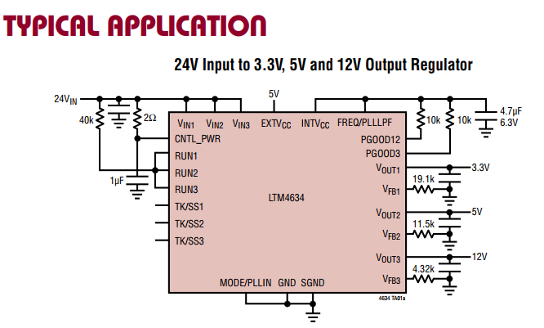
Low Voltage D3V3P_D2VP_A6VP_A6VN “ LTM4634 ”

Slide 5
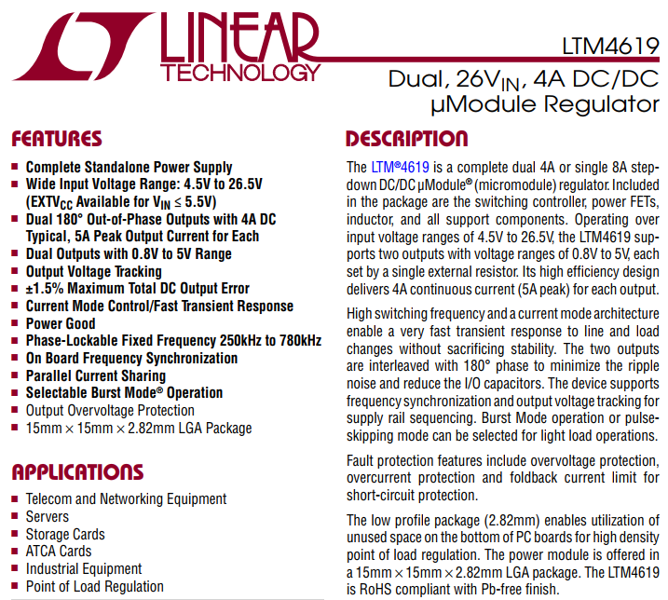
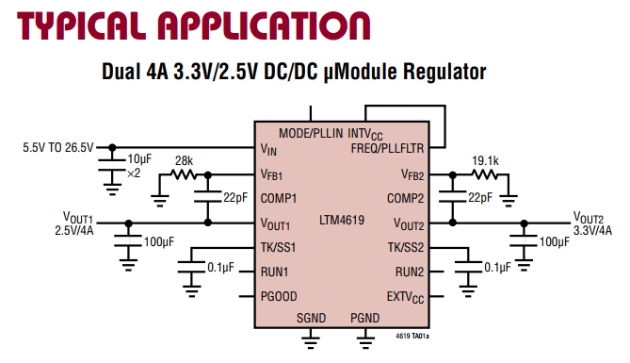
Low Voltage D3V5P_D5VP “ LTM4619 “

Slide 6
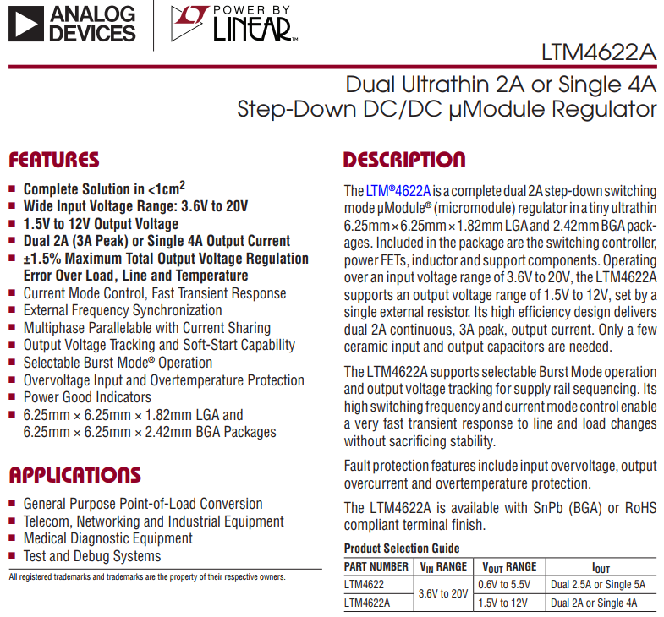
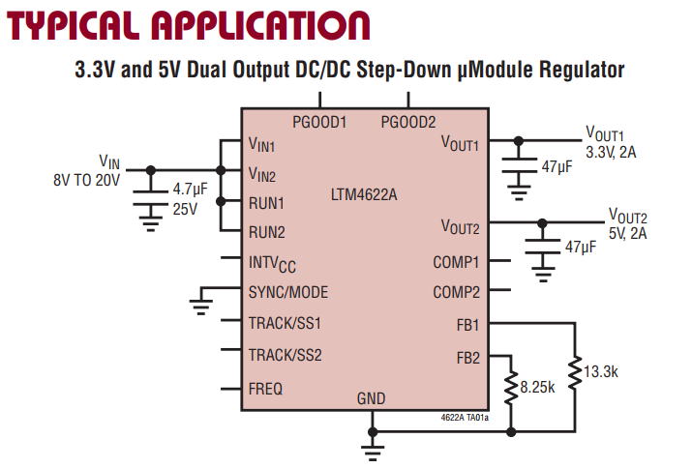
Low Voltage A12VP “ LTM4622 “

